Slide 1


TRAINING
DIGITAL LITERACY CONTENT DEVELOPMENT
Nov, 2025
Addis Ababa, Ethiopia

Slide 2

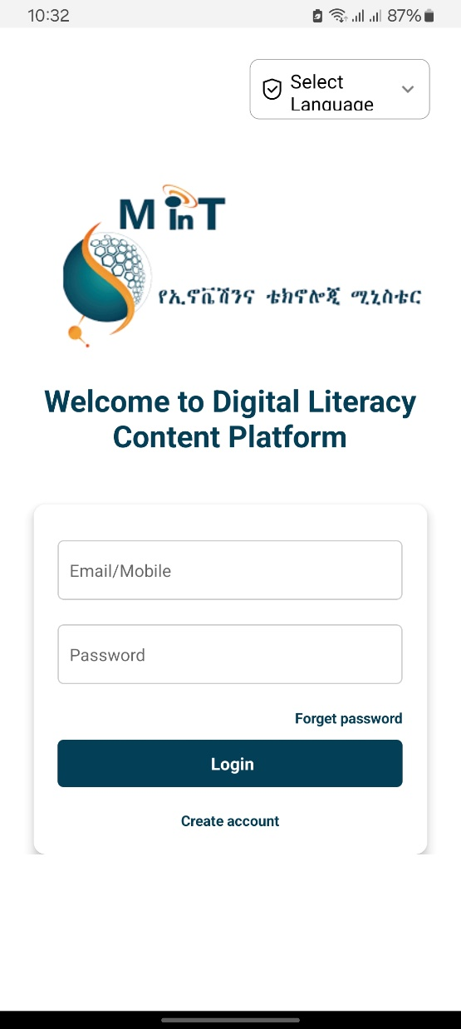
TABLE OF CONTENT
Learning objective of training
Project objective and scope
Content development process
Inclusive content design principle
Localization and cultural adaptation
Procedure in creating digital content
Storyboarding techniques
Planning for low bandwidth
The power of metadata & tagging
Other tools
Responsive & multi-device design
Challenges faced and solution
Conclusion

Slide 3
SESSION I

Slide 4
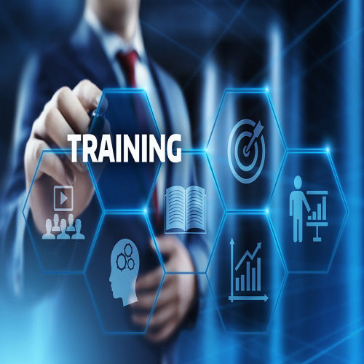
LEARNING OBJECTIVES
Learning objective of this training is:
Learn to create high-quality, localized educational materials in ten Ethiopian languages.
Gain knowledge in developing content for 4 sectors such as:
Agriculture
Health
Child Education
IT and Digital Literacy

Slide 5
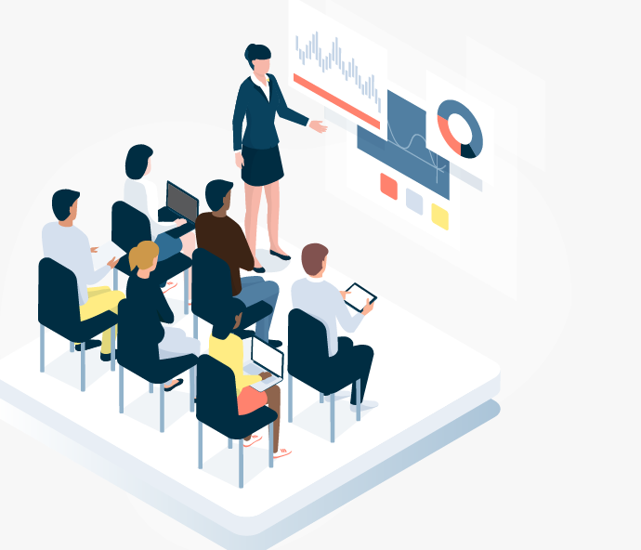
CONT …
Learn to utilize tools like:
Articulate Storyline 360 for learning content.
Clipchamp for video editing.
Subtitle Edit for adding subtitles.
Handbrake for video compression
Understand techniques to make digital content accessible to all, including individuals with disabilities (e.g., subtitles for hearing-impaired).
Gain practical Knowledge and Skills

Slide 6
OVERVIEW OF PROJECT
Ethiopia is diverse linguistic landscape and predominantly rural population.
To Promote inclusivity and ensure that all citizens benefit from digital services, it is imperative to create localized content that resonates with different cultural and linguistic groups.

Slide 7
CONT …
Developed a mobile app and 400 educational videos in 10 Ethiopian languages.
Addressed four critical sectors: Agriculture, Health, Child Education, and IT.
Empowered learners in remote areas with accessible, offline-compatible content.

Slide 8
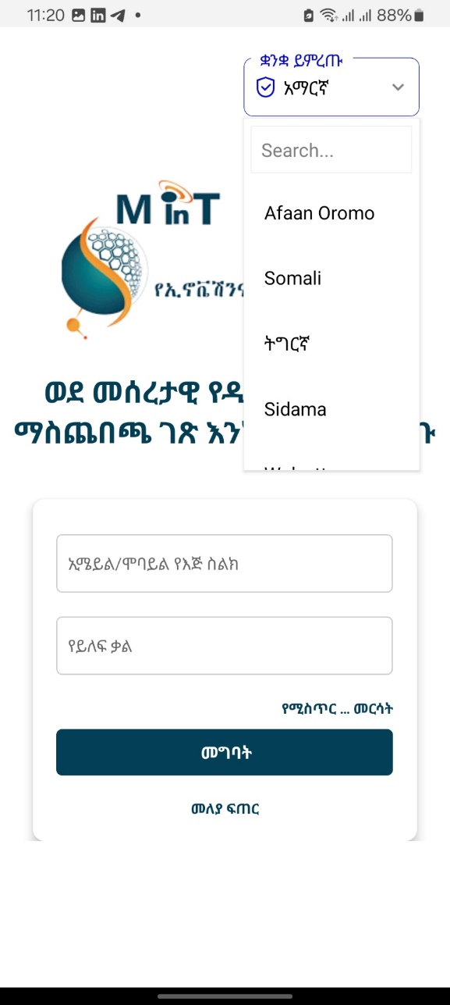
PROJECT OBJECTIVES
Bridge the Digital Knowledge Gap.
Improve Livelihoods

Slide 9
PROJECT SCOPE
This project's scope is to develop a mobile application for the Android platform and digital literacy content in ten widely spoken local languages based on the Central Statistic Agency and Ministry of Innovation and Technology confirmation.

Slide 10
CONTENT DEVELOPMENT PROCESS
Sectors Addressed
The four sectors were selected and confirmed by the Ministry of Innovation and Technology.
The Topics for agriculture, health, child education, and Digital literacy were approved and confirmed by the Ministry of Agriculture Ministry of Health, Ministry of Education, and Ministry of Innovation and Technology respectively.
Audience
Farmers, parents, educators, and young students in rural and semi-urban areas.

Slide 11
CONT …
1. Research and planning
Intracom has selected five highly qualified content developers for the four sectors
No. | Full Name | Title | Profession | Contributions
1. | Dr. Kirubel Misganaw Abdeta | Medical Doctor | General Practitioner | Consultant, Digital Health Content Developer and Translator (to Amharic language)
2. | Dr. Feven Seyoum Abraham | Medical Doctor, Project Manager |  | E-Learning Developer for the Childhood Education section of the project
3. | Prof. Alemayehu Lemma | Professor of Veterinary Obstetrics and Gynecology | Veterinarian | Developed digital content in three areas under the Agriculture domain
4. | Dr. Dinkenesh Abera | Doctor of Agriculture | Instructor environmental science, agriculture, or a related field | Developed digital content in Seven areas under the Agriculture domain
5. | Wendwesen Endale (Msc ,MBL) | Information systems instructor and Knowledge Management advisor |  | IT courses e-learning developer Contributions: Consultant, Digital Literacy Content Developer and Translator (in Amharic language)

Slide 12
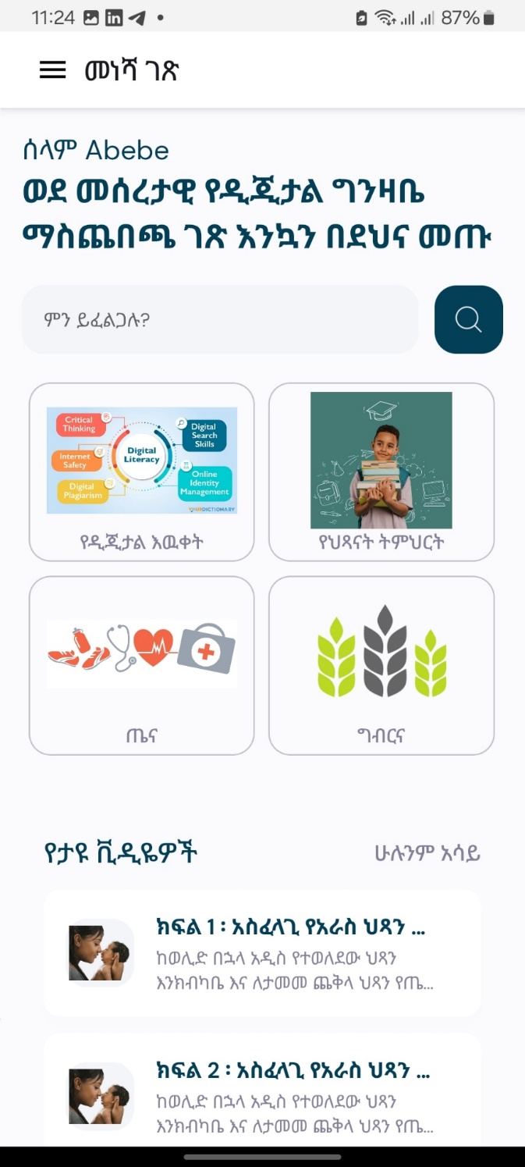
CONT …
2. Identifying topics
Each content developer prepared more than 15 topics for their respective sectors.
These selected topics were approved and confirmed by the respective ministries:
Ministry of Agriculture,
Ministry of Education,
Ministry of Health, and
Ministry of Innovation and Technology.

Slide 13
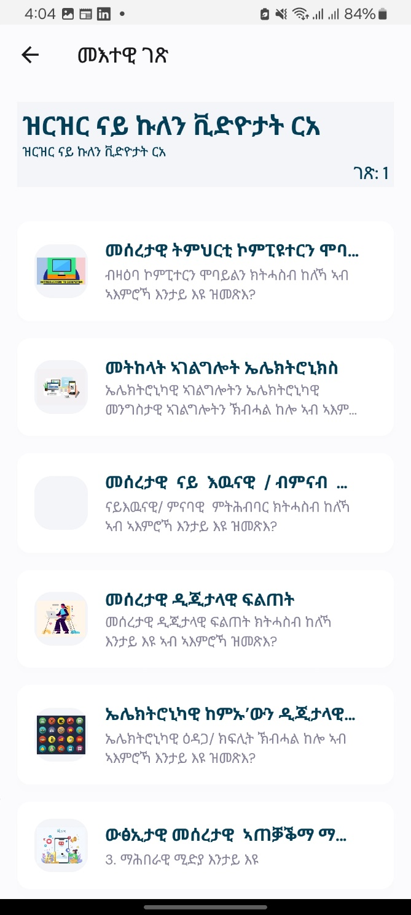
APPROVED TOPICS
Digital Literacy 10 topics
Online job searching using the Internet
Basic email communication principles and services
Safety and safety guidelines to prevent digital attacks
Effective social media use and personal image-building
Basic digital literacy
Basic principles of digital Marketing
Electronic and digital marketing/payment basics
Basics of real/virtual collaboration
Basics of electronic services.
Basics of computers and mobile phones

Slide 14
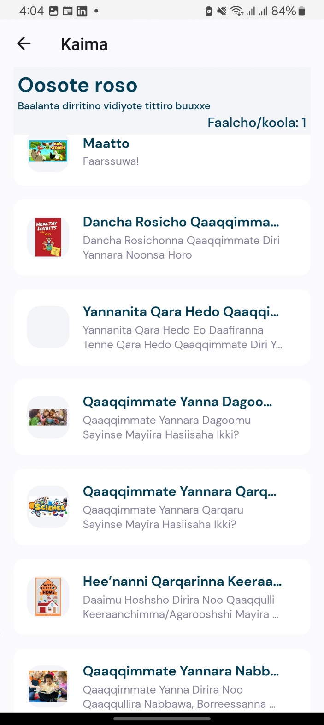
CONT …
Child Education: 10 topics
Early Childhood Development, Education and Care
Play-Based learning
Math
Literacy
General Science
Understanding Home Environment and Safety Rules
Social Studies
Time, Days, Months and Weather
Healthy and Physical Development
Stories and Rhymes

Slide 15
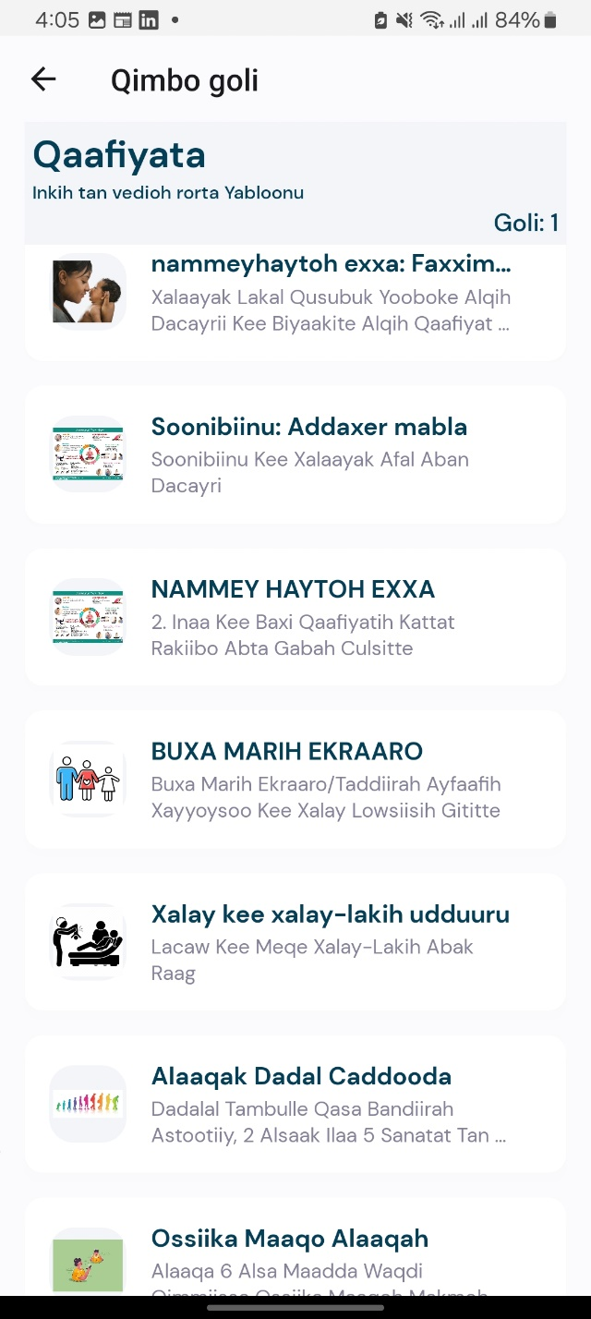
CONT …
Health: 8 topics
Health Vaccination of children and its importance
Breastfeeding only breast milk for the first 6 months of life
Complementary food for babies
Essential neonatal care
Pregnancy and prenatal care
Partum and postpartum period
Family planning
Children's developmental stages

Slide 16
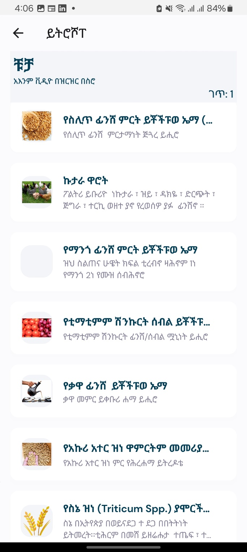
CONT …
Agricultural: 10 topics
Wheat cultivation
Rice cultivation
Sesame cultivation
Soybean cultivation
Plant/onion and tomato cultivate
Fruit/ avocado and banana
Coffee cultivation
Dairy cattle and camels
Egg and meat poultry
Beekeeping/beekeeping

Slide 17
INCLUSIVE CONTENT DESIGN PRINCIPLES
Designed with accessibility in mind, the platform supports features like subtitled video content, responsive layouts, and voice-over narration, making it usable for individuals with varying literacy levels and abilities.
Additionally, the inclusion of culturally relevant examples, localized content, and intuitive navigation ensures that users from all regions can connect with the material seamlessly.
This approach not only enhances digital literacy and practical skills but also empowers underserved communities to access critical knowledge that improves livelihoods and fosters societal growth.

Slide 18
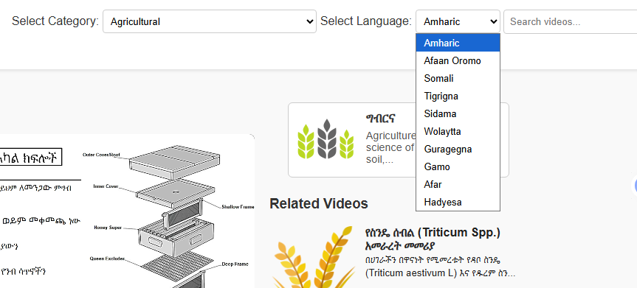
CONT …
Multilingual Accessibility
Develop content in 10 widely spoken local languages, ensuring linguistic inclusivity.
Use voice narrations and subtitles in local languages.

Slide 19
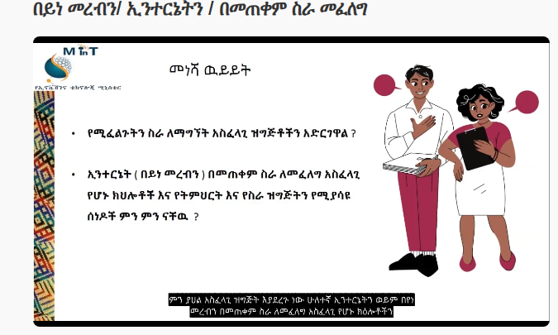
CONT …
Accessibility for disabilities
Ensure content is accessible to people with disabilities:
Audio narrations for visually impaired users.
Subtitles interpretations for hearing-impaired users.
Simplified and intuitive navigation for users with limited literacy or digital skills.

Slide 20
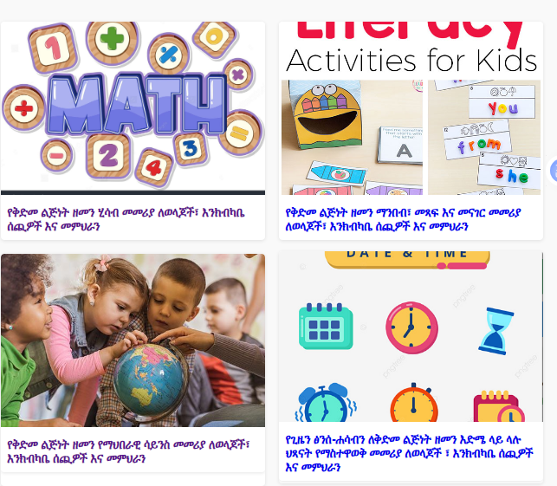
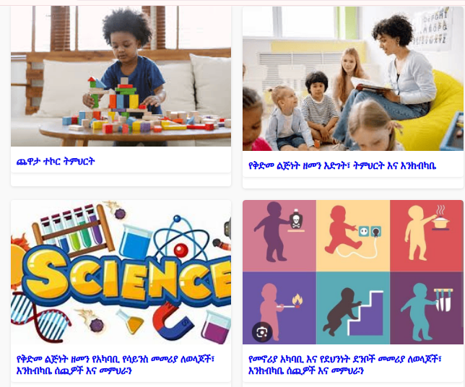
CONT …
Technological Accessibility
The system is descriptive images and demo videos across all sectors to enhance understanding and engagement.
Offline capability
Responsive design

Slide 21
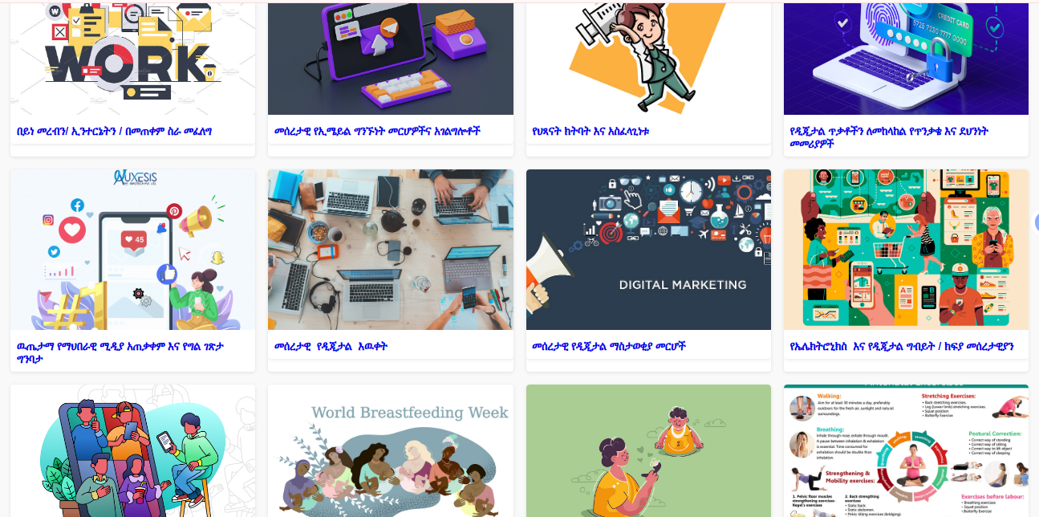
CONT …
For example, in the IT sector, demo videos provide step-by-step guidance on practical topics such as how to create an email account, how to use social media effectively, or how to perform online job searches.

Slide 22
CONT …
The project is designed to be inclusive for all genders, ensuring that the content addresses the needs and interests of everyone, regardless of gender, and promotes equal access to learning opportunities.
Example: Health and Child Education
Empower parents and teachers to assist children in navigating digital platforms.
Provide step-by-step tutorials for adults on topics like effective social media use, online job searching.

Slide 23
LOCALIZATION AND CULTURAL ADAPTATION
Localization and cultural adaptation are essential parts of digital content development to ensure that educational materials are accessible, relevant, and culturally sensitive to Ethiopia’s diverse population.
In the Digital Literacy Content Development Project, content was translated into ten local languages and culturally adapted to reflect everyday realities, social norms, and communication styles.
This process involved collaboration with language experts, adapting visuals and audio, and ensuring inclusivity through subtitles and voice narration.
As a result, the project achieved broad accessibility and cultural resonance among all user groups.

Slide 24
LOCALIZATION VS. TRANSLATION
Translation: Converting text from one language to another.
Localization: Adapting the entire experience to a local culture.
Examples:
Using local currency (Birr) in examples, not dollars.
Showing Ethiopian farming tools, not foreign ones.
Using culturally relevant stories, jokes, and analogies.
Ensuring visuals (clothing, settings) are familiar.

Slide 25
OUR LOCALIZATION PROCESS IN ACTION
Step 1: Expert content creation in Amharic/English.
Step 2: Translation by native-speaking linguists and PhD holders.
Step 3: Cultural adaptation of visuals and examples.
Step 4: Integration of localized voice-overs and subtitles.
Step 5: Validation by native speakers for authenticity.

Slide 26
MOBILE FIRST
This approach prioritizes the design and functionality of the mobile version of the platform, recognizing that mobile devices are far more accessible and affordable than laptops or desktop computers in the rural areas.

Slide 27
OFFLINE FUNCTIONALITY PLANNING
The system is designed to support offline access once the user has an active internet connection to download the necessary content.
After the initial download, users can view videos, read materials, and access previously saved resources without requiring an internet connection.
This feature ensures continuous learning and accessibility, particularly in remote areas with limited connectivity.

Slide 28
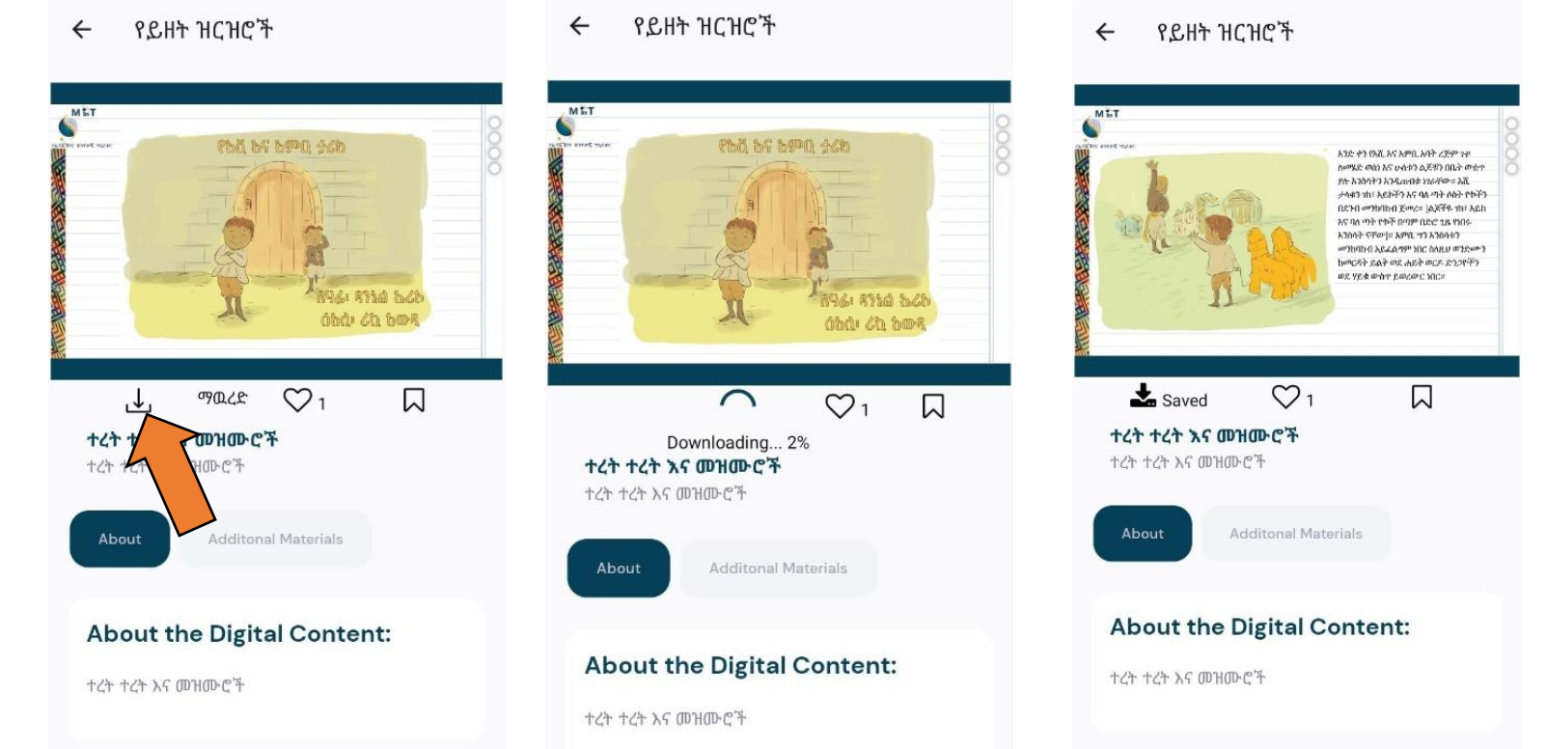

Slide 29
SESSION II

Slide 30
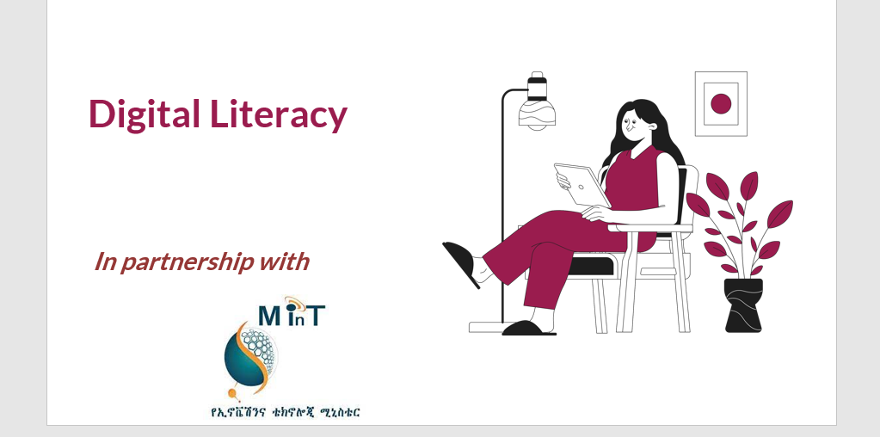
PROCEDURE IN CREATING DIGITAL CONTENT
After the approval of 10 topics for each sector, the content developers proceeded to prepare detailed content for Amharic and English language. This includes:
PowerPoint Presentations
Recorded Voice Narration
To facilitate translation into nine additional languages, we have partnered with university lecturers who have a strong linguistic background and some of our translators have a PHD holders.

Slide 31
CONT …
Language | Universities we partnered with
Sidama | Hawasa University
Gamo | Arbaminch University
Wolayta | Wolayta Sodo University
Hadiya | Wachamo University
Afar | Semera University
Somalia | Jigjiga University
Gurage | Welkite University

Slide 32
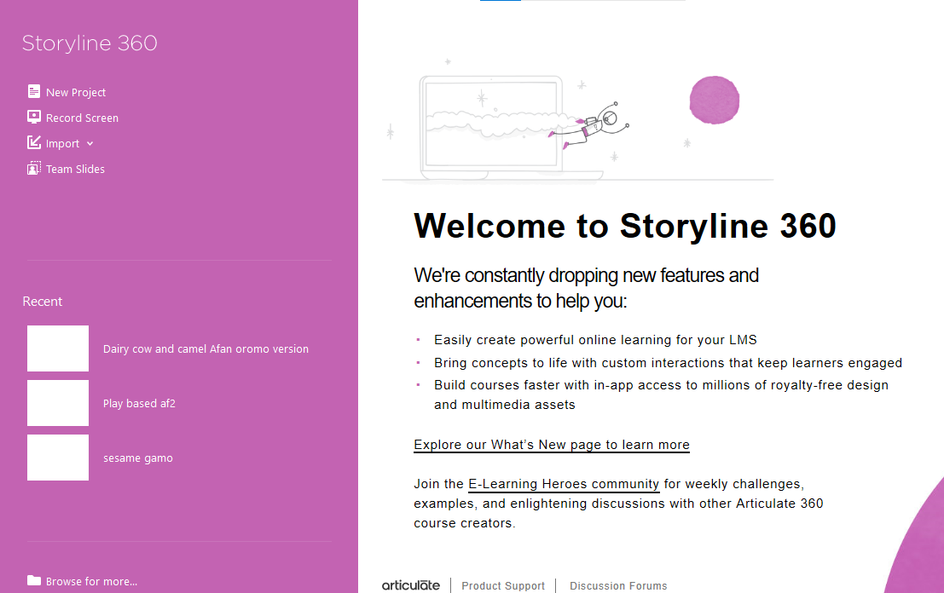
STORYBOARDING TECHNIQUES
1. Articulate 360, storyline 360
Integration Process Using Storyline 360
Intracom utilizes Articulate Storyline 360 to integrate PowerPoint slides with recorded voice narration for creating interactive and engaging e-learning content.

Slide 33
CONT …
Key Features of Articulate Storyline 360
Interactive Course Creation
Responsive Design
Templates and Assets
Multimedia Integration
Intracom utilizes this application for multimedia integration, allowing for the seamless combination of PowerPoint presentations and recorded voice narration.

Slide 34
CONT …
Import PowerPoint Slides
The process begins with importing the PowerPoint presentation into Storyline 360:
Open the software and select the Import option.
Choose PowerPoint and locate the presentation file.
Select the slides to be imported and insert them into the project.

Slide 35
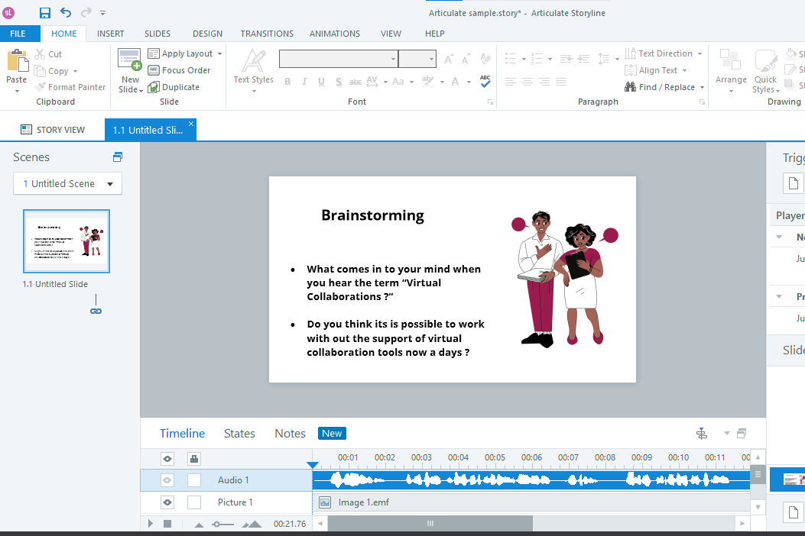
CONT …
b) Add Voice Narration for Each Slide
The translator records a separate audio file for each slide. These voice narrations are then integrated individually:
Select a slide in the project.
Go to Audio > Import Audio, and upload the corresponding audio file.
The audio is displayed in the Timeline Panel, where it can be synchronized with any animations or transitions.

Slide 36
CONT …
c) Repeat for All Slides
This process is repeated for each slide, ensuring that the correct narration is matched to the respective slide.
d) Preview and Adjust
Once all audio files are integrated, the project is previewed to verify synchronization between slides, narration, and animations. Adjustments are made as necessary.

Slide 37
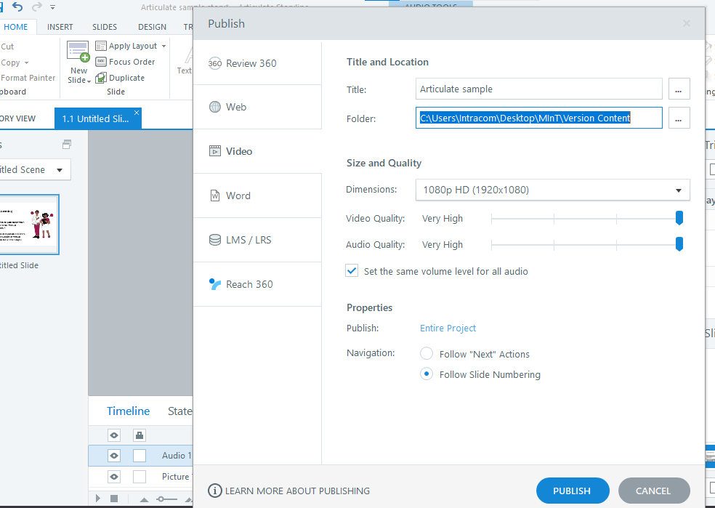
CONT …
e) Publish the Final Module
After finalizing the project, it is published in the required format (e.g., LMS, video, or web) for deployment.

Slide 38
CONT …
Question
What challenges do you face when using Storyline 360?

Slide 39
CONT …
SESSION III

Slide 40
PLANNING FOR LOW-BANDWIDTH
2. Handbrake
Planning for Low-Bandwidth
Challenge: Large video files are slow to download and buffer constantly.
Our Solutions:
Tool: HandBrake for compression.
Design: Use simple graphics instead of high-motion video where possible.
Content: Break long topics into shorter, focused videos.

Slide 41
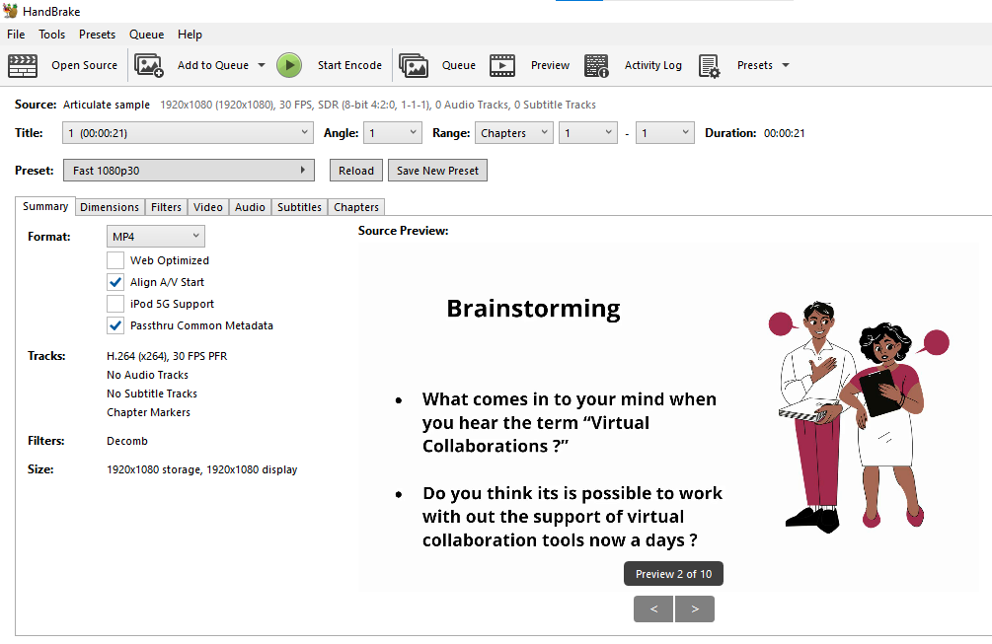
CONT …
2. Handbrake
Intracom uses this software to reduce file sizes without compromising video quality, enabling efficient storage, faster uploads, and seamless sharing across platforms.

Slide 42
CONT …
Convert nearly any video to MP4 or MKV
Crop and resize video
Restore old and low-quality video
Remove combing artifacts caused by interlacing and telecine
Pass-through audio without conversion for certain audio types
Down mix discrete surround sound to matrixed surround or stereo
Adjust audio volume levels, and dynamic range for certain audio types

Slide 43
THE POWER OF METADATA & TAGGING
What is Metadata? "Data about your data." (e.g., Title, Language, Sector, Topic, Keywords, Duration).
Why it's Vital:
Discoverability: Makes content searchable in the app (e.g., a user searches for "tomato").
Organization: Allows filtering by language, sector, etc.
Management: Helps admins track and manage the content library.
Hands-On Exercise Prompt: "Let's define the metadata fields we will use for all our videos."

Slide 44
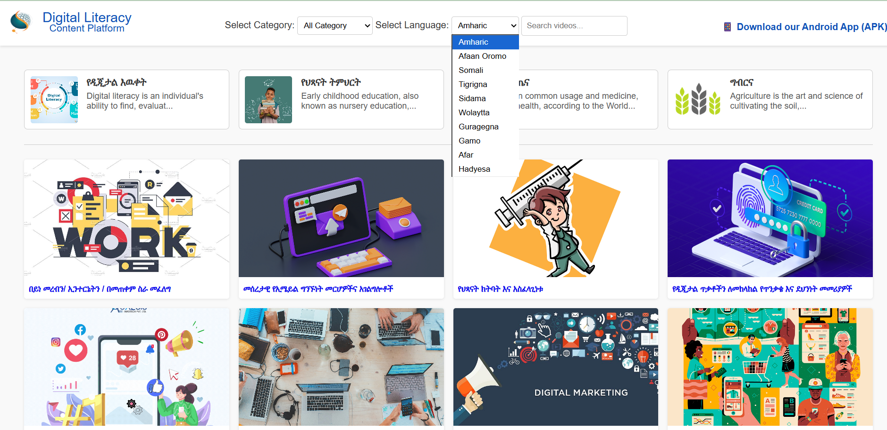
Organization (filtering by language)

Slide 45
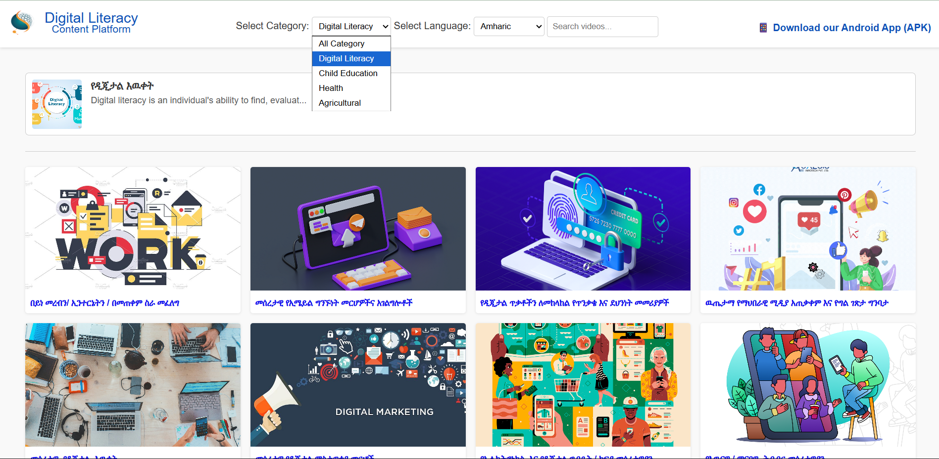
Organization (filtering by sector)

Slide 46
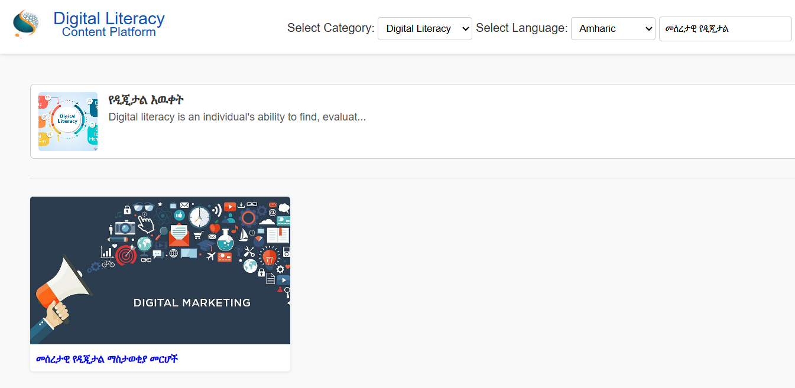
Discoverability

Slide 47
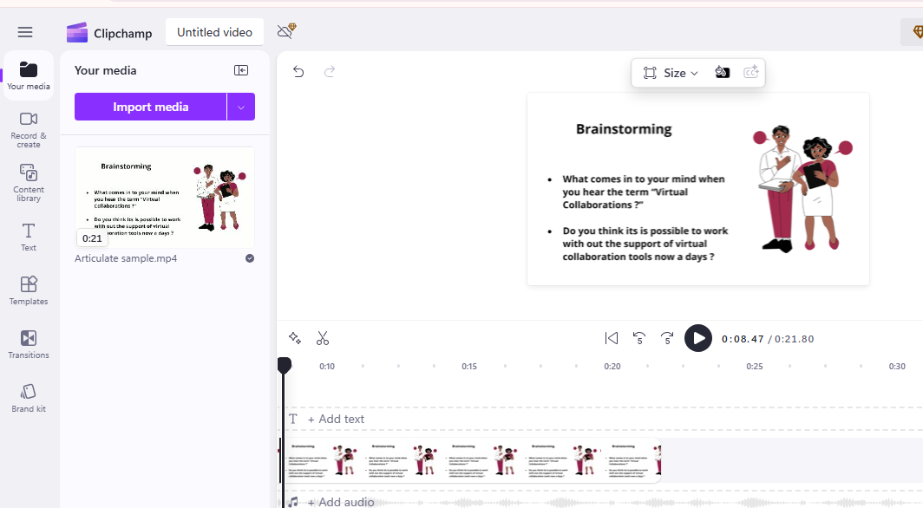
OTHER TOOLS
3. Clipchamp
is an online video editing platform that provides users with a simple yet powerful way to create and edit videos directly in a web browser.

Slide 48
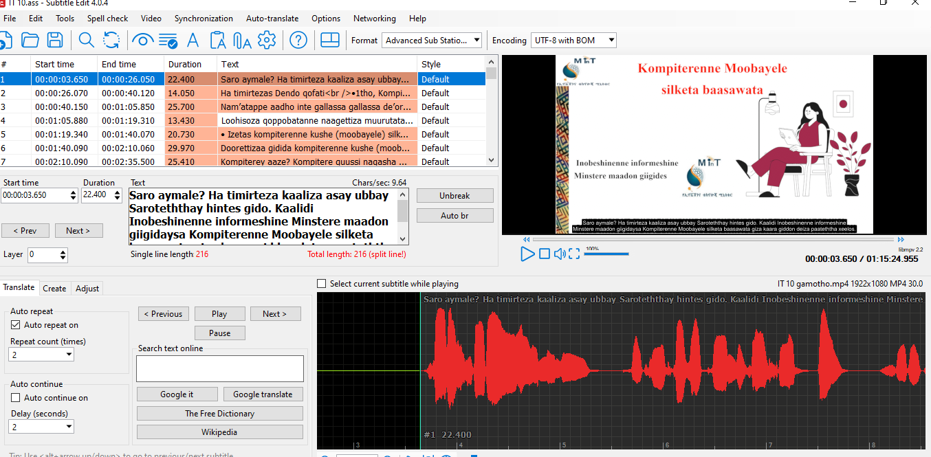
CONT …
4. Subtitle edit
Intracom utilizes Subtitle Edit as its primary application for adding subtitles to video content.

Slide 49
CONT …
Question
What challenges do you face when using Handbrake, subtitle edit and clipchamp?

Slide 50
CONT …
SESSION IV

Slide 51
Responsive & Multi-Device Design
Desktop interface
Open an Internet Browser: Use any browser such as Chrome, Google, or Microsoft Edge.
Enter the URL: Type https://dlc.gov.et/ into the address bar of your browser

Slide 52
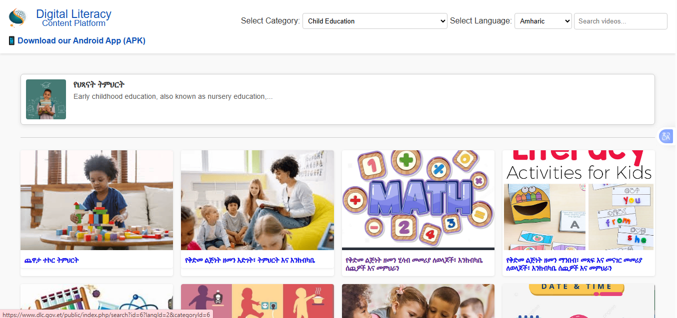
Responsive & Multi-Device Design
Desktop interface
Category section
Language section

Slide 53
CONT …
Android Phone Interface
Step-by-step procedure:
Open an Internet Browser: Use any browser such as Chrome, Google, or Microsoft Edge.
Enter the URL: Type https://dlc.gov.et/ into the address bar of your browser.
On the webpage, find the section labeled Download our Android App (APK).

Slide 54
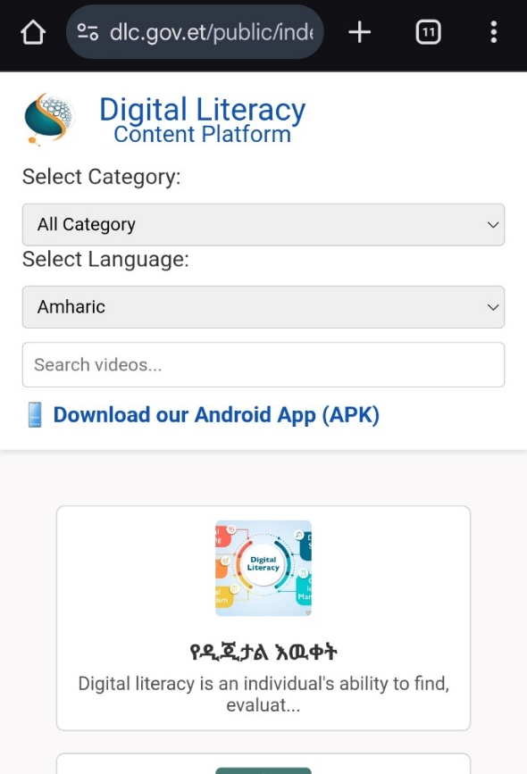
CONT …
5. Click on the Link: Tap on the link to start downloading the APK file.
Once you click on the Download our Android App (APK) link, the download process will start automatically.

Slide 55
CONT …
Once the installation is complete and you open the application, the Login page will appear as shown below.

Slide 56
Login Page
Click if you have an account
Click to create new account

Slide 57
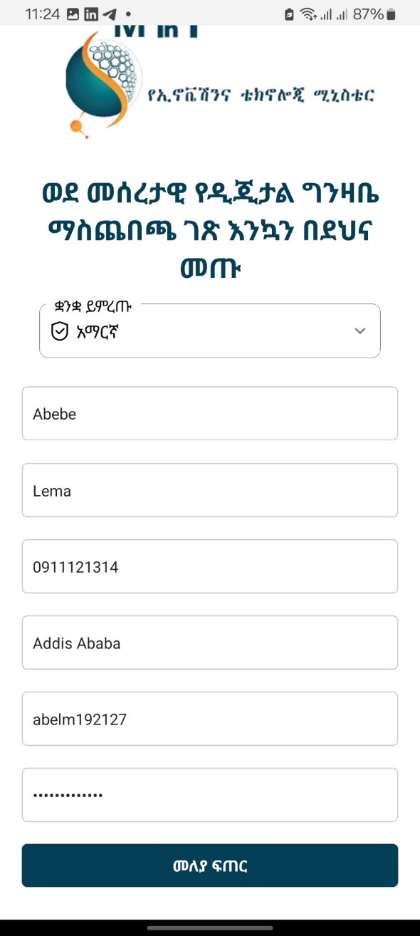
2. Register a New Account

Slide 58
3. Home Dashboard

Slide 59
CHALLENGES FACED AND SOLUTION
Challenges
Challenge 1: Delays in topic approval for more than a year by sectoral ministries impacted the project timeline, requiring adjustments to ensure alignment with ministry expectations.
Challenge 2: Most of the languages are undeveloped.
Challenge 3: Expertise in the languages is very few.

Slide 60
CONT …
Solutions
Language Standardization Initiatives: Collaborate with linguists University professors and experts to develop standardized orthographies and expand lexicons.
Community Involvement: Engage native speakers in the creation and validation of content to ensure authenticity.
Researched documents: Utilize or create digital resources to aid in the development of these languages, such as vocabularies or grammar resources.

Slide 61
CONCLUSION
By delivering high-quality, multilingual educational content in ten local languages, the project addresses critical sectors such as Agriculture, Health, Child Education, and IT, equipping communities with practical knowledge and skills to improve their livelihoods.

Slide 62
THANK YOU

